Slide 1
LAPTOP PRICE PREDICTION
FOR SMART TECH CO
This Photo by Unknown Author is licensed under CC BY-SA

Slide 2
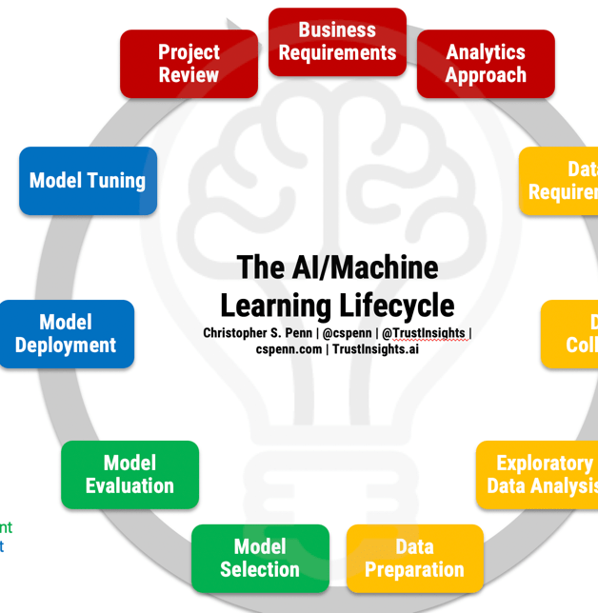
What is machine learning
Machine learning is a branch of Artificial intelligence that deals with implementing applications that can make a future prediction based on past data.
There are various steps involved in building a machine learning project but not all the steps are mandatory to use in a single project, and it all depends on the data.

Slide 3



LAPTOP PREDICTION MODEL
WHY WE NEED LAPTOP PRIDICTION MODEL ?
Consumers often face the challenge of navigating through various options to find a laptop that meets their requirements and budget constraints. Additionally, market fluctuations and the rapid pace of technological advancements contribute to the complexity of understanding and predicting laptop prices.

Slide 4
Project Overview:
Smart Tech Co. has partnered with our data science team to develop a robust machine learning model that predicts laptop prices accurately. As the market for laptops continues to expand with a myriad of brands and specifications, having a precise pricing model becomes crucial for both consumers and manufacturers

Slide 5
Table of Contents
Describing Problem Statement
Overview about dataset
Data Cleaning
Feature engineering
Exploratory Data Analysis
Model training, Model testing
Machine learning Modeling
Questions related to our observation
ML web app development
Deployment Machine learning app

Slide 6



Solution We will make a project for Laptop price prediction.
Problem Statement
The problem statement is that if any user wants to buy a laptop then our application should be compatible to provide a tentative price of laptop according to the user configurations.

Slide 7
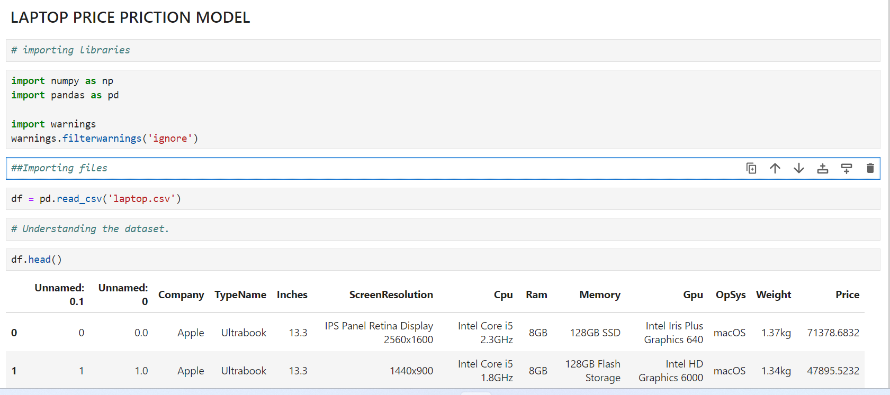
Basic Understanding of Laptop Price Prediction Data
[df.shape] # Checking no of rows and no columns.
## In this dataset we have; ### ROWS = 1308 ### COLUMNS = 13

Slide 8
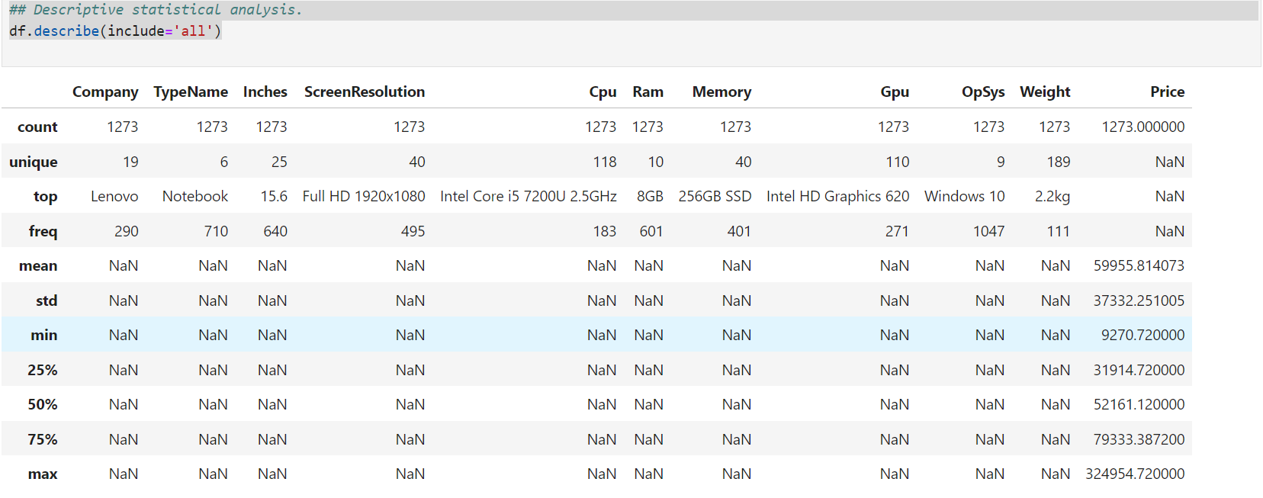
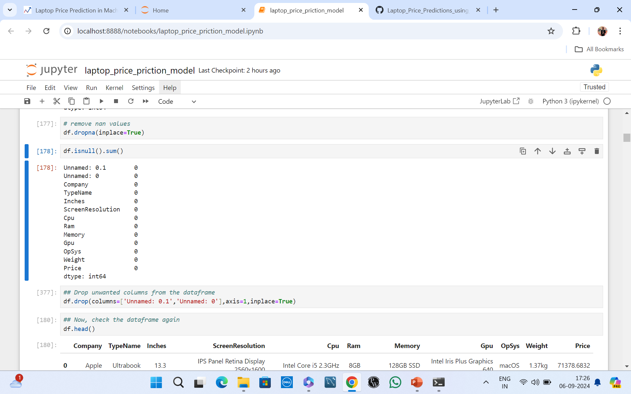
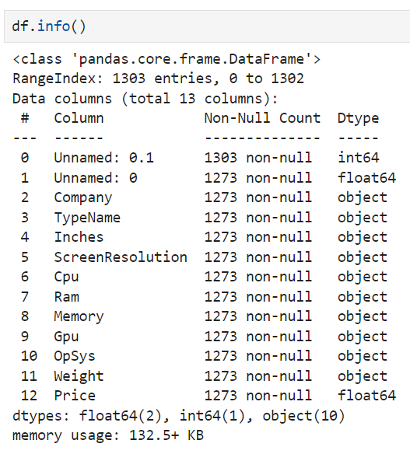
## Descriptive statistical analysis.
df.describe(include='all')
# Checking no of rows and no columns.
[df.shape]
In this dataset we have;
ROWS = 1308
COLUMNS = 13
# remove nan values
df.dropna(inplace=True)
df.info()

Slide 9
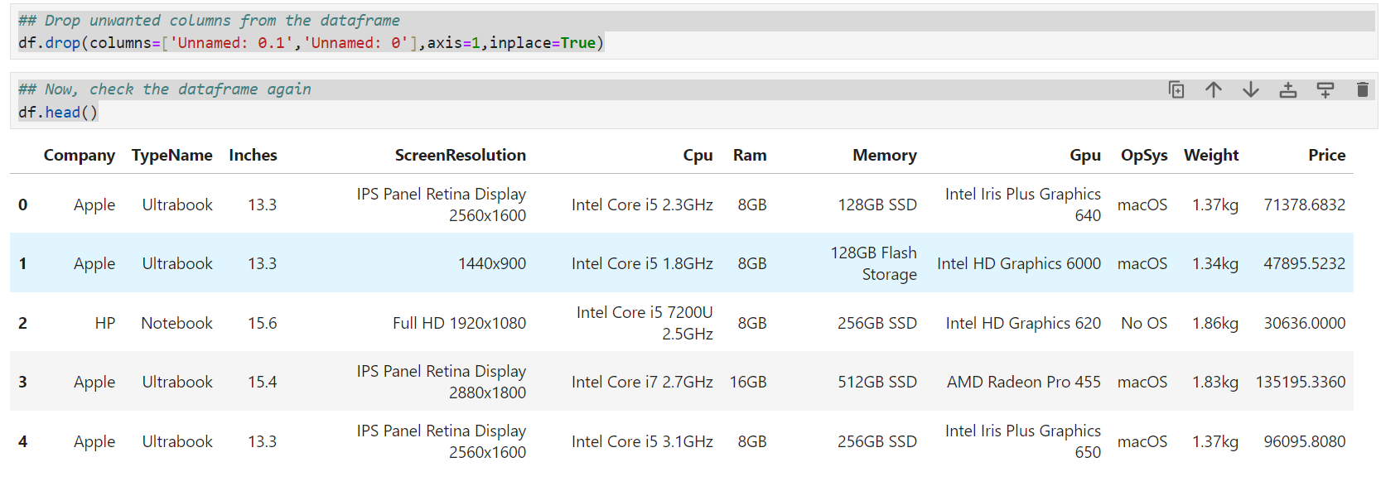
Data cleaning & Feature Engineering
## Drop unwanted columns from the dataframe
df.drop(columns=['Unnamed: 0.1','Unnamed: 0'],axis=1,inplace=True)
## Now, check the data frame again df.head()

Slide 10
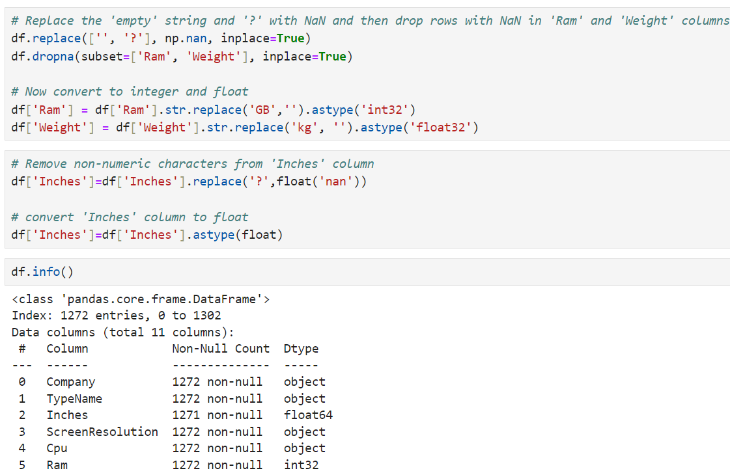
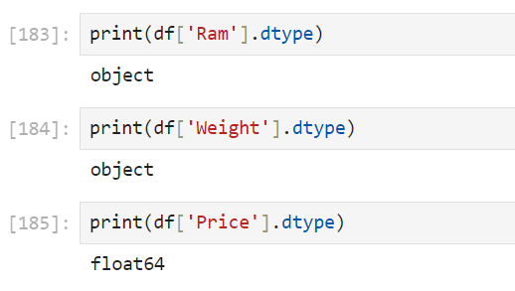
# Now, you can se that ram is object, we will change it to [int].
# Weight is also object i will change it to [float].
# Change inches dtpe into [float].

Slide 11
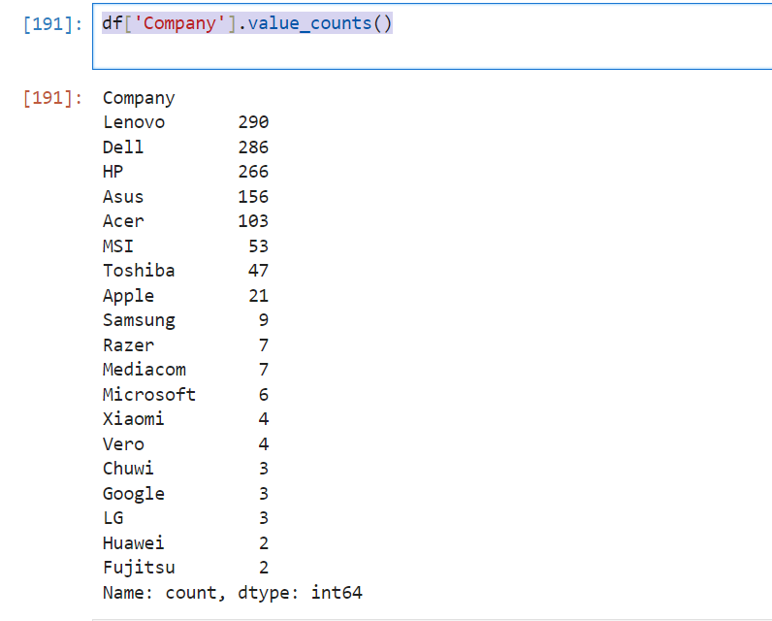
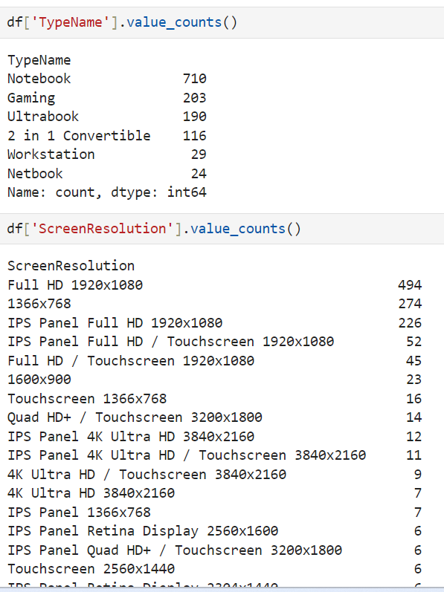
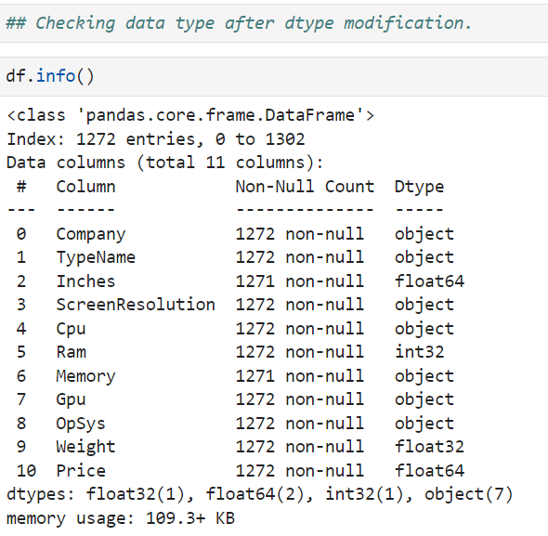
df['Company'].value_counts()
## Checking data type after dtype modification.
df['TypeName'].value_counts()
df['Screen Resolution'].value_counts()

Slide 12
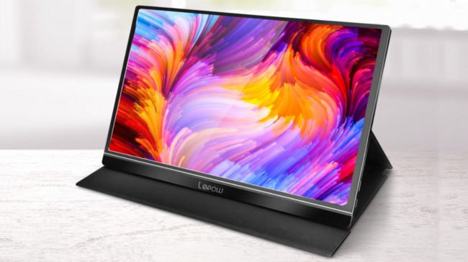



Feature Engineering over screen resolution column
There are some hidden specifications in Screen resolution column which we have to find out and create a separate column for it.
Screen resolution
IPS PANEL RETINA SISPLAY
TOUCH SCREEN
df['IPS'] = df['Screen Resolution'].apply(lambda x: 1 if 'IPS' in x else 0)
df['Screen Resolution'].apply(lambda x:1 if 'Touchscreen' in x else 0)

Slide 13
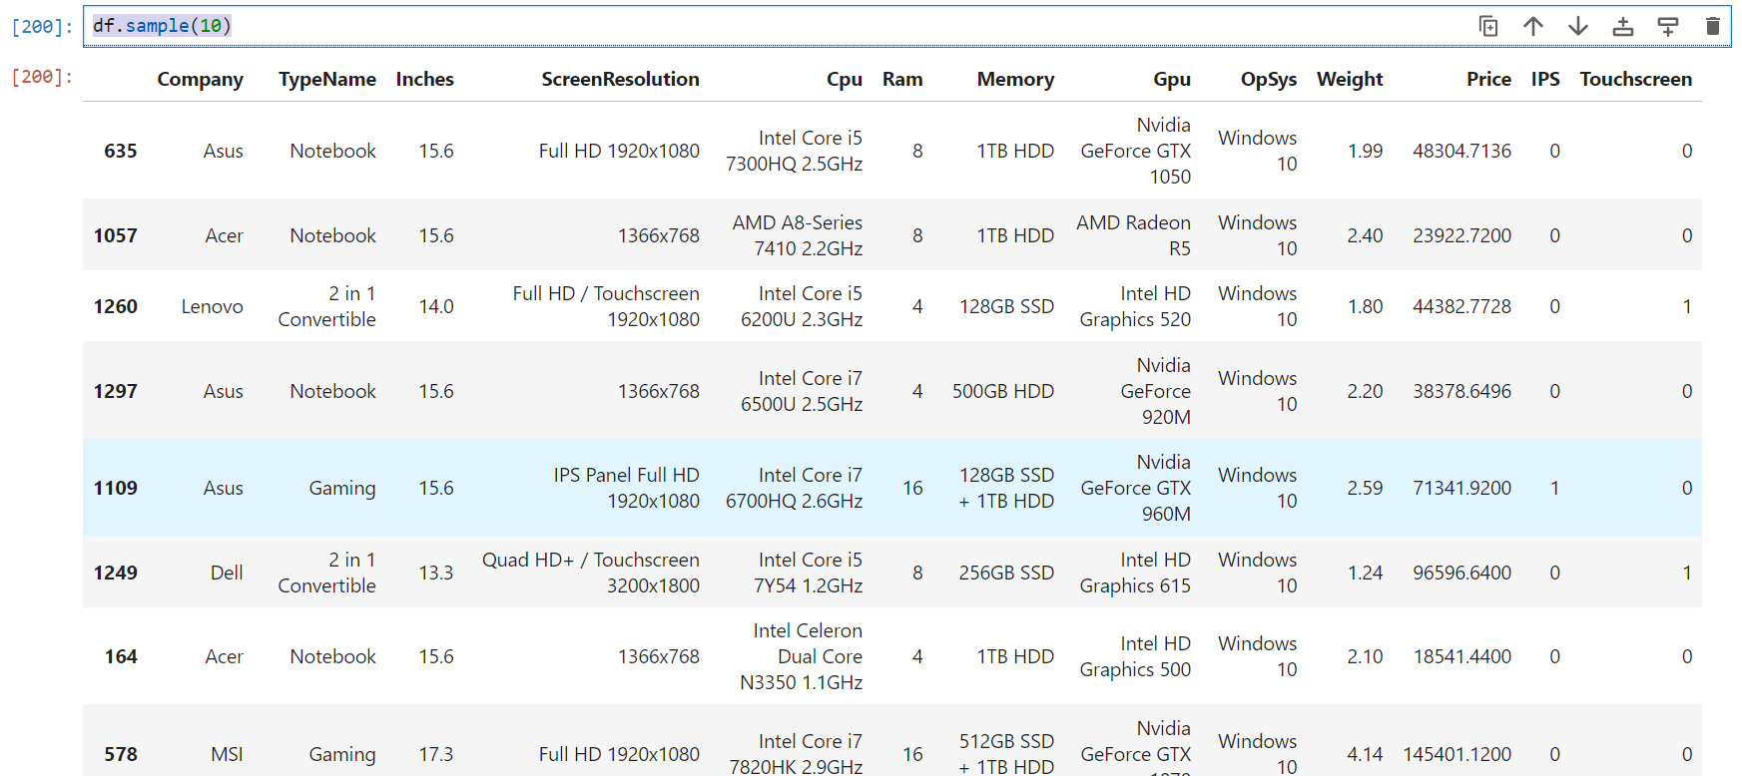

df.sample(10)

Slide 14
Create two new columns : df['Screen Resolution'].str.split('x',n=1,expand=True) ## Creating two new columns ..x_res,y_res df['X_res'] = new[0] df['Y_res'] = new[1]
We split it into X_res and Y_res
X resolution
Screen
Resolution
X_res
Y_res
Y resolution

Slide 15
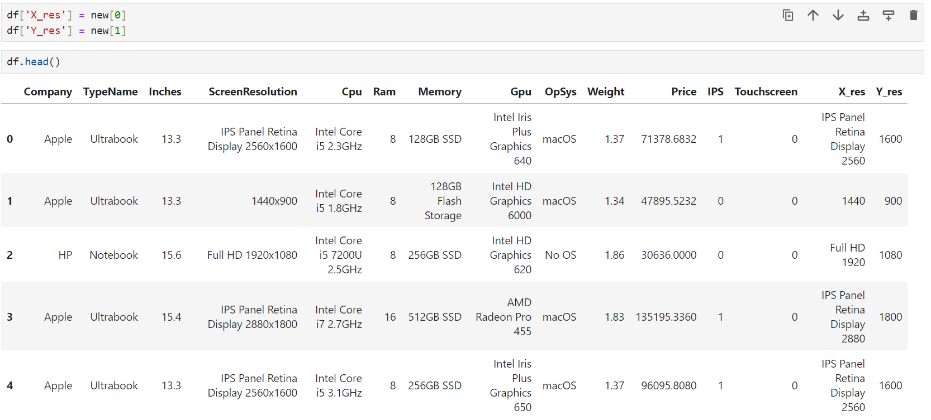
df.head()
Notes:
Now you can see two new columns.

Slide 16
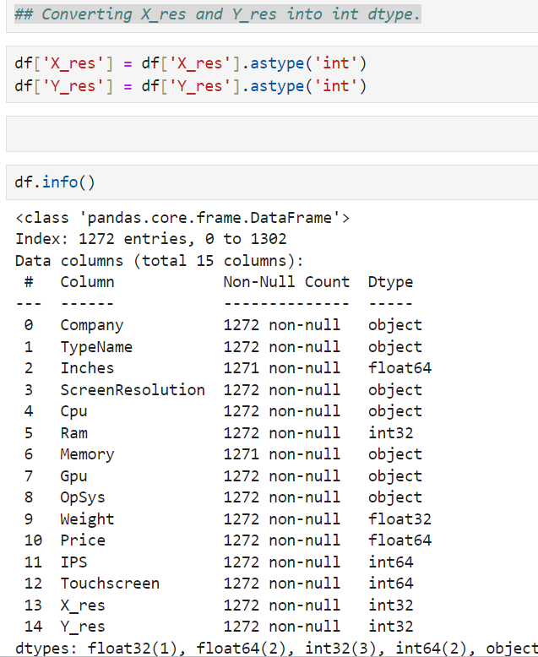
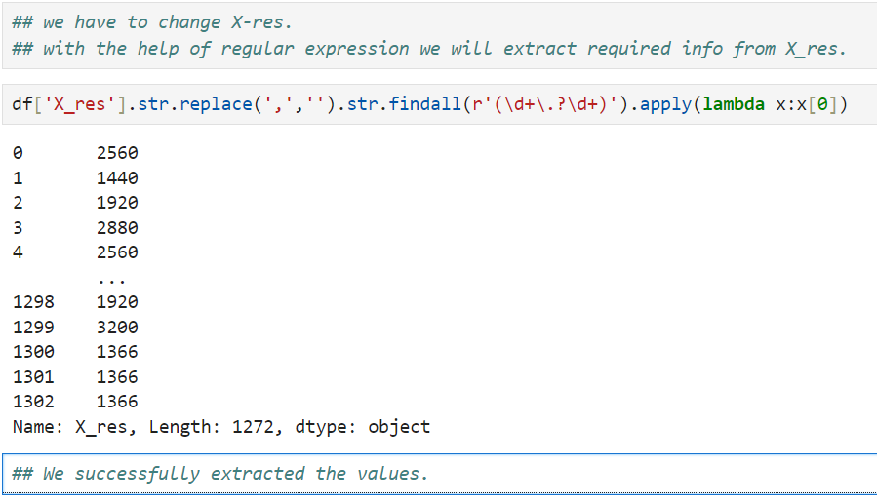
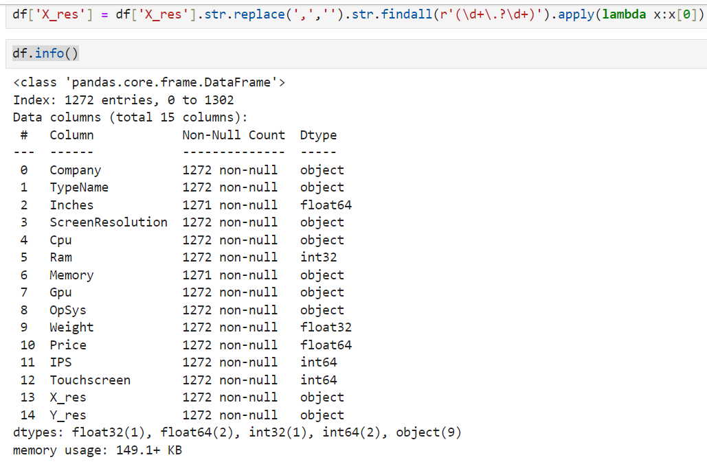
## we have to change X-res.## with the help of regular expression we will extract required info from X_res.
## Converting X_res and Y_res into int dtype.
df['X_res'].str.replace(',','').str.findall(r'(\d+\.?\d+)').apply(lambda x:x[0])

Slide 17
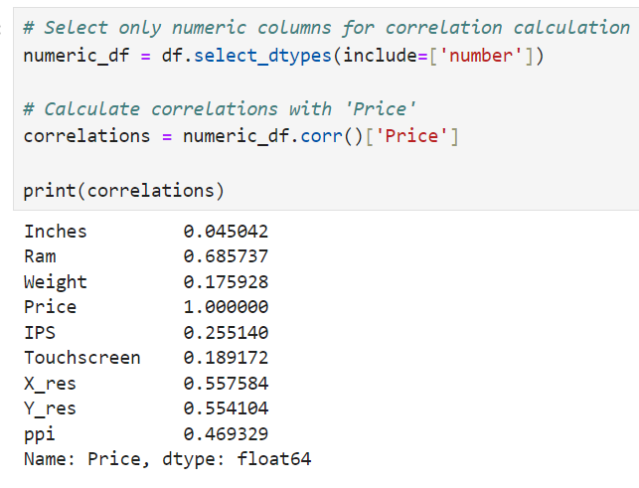
## Now we will create a new column i.e, PPI
### What is pixel per inch (PPI)?# The term Pixels Per Inch (PPI) commonly refers to the measurement of pixel density in display screens, including those of computers, laptops, TVs, and smartphones. # This metric helps you determine the sharpness and clarity of the image you see on the screens of these devices. # PPI is a metric used for all kinds of screens
df['ppi'] = (((df['X_res']**2) + (df['Y_res']**2))**0.5/df['Inches']).astype('float')
We check correlation to understand more about numeric columns and which are least important.

Slide 18
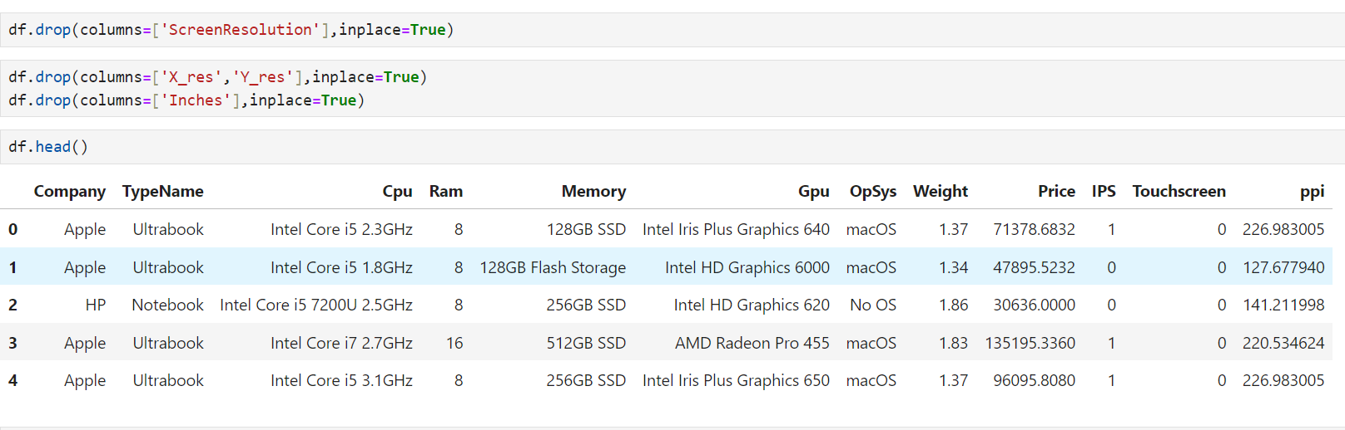
Now we will remove some columns which are of no use in future.
we will drop Inches,ScreenResolution,X_res,Y_res.

Slide 19
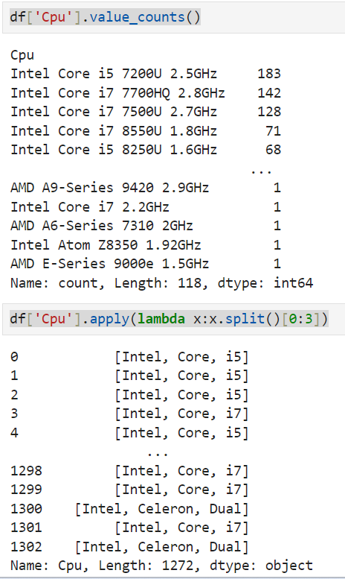
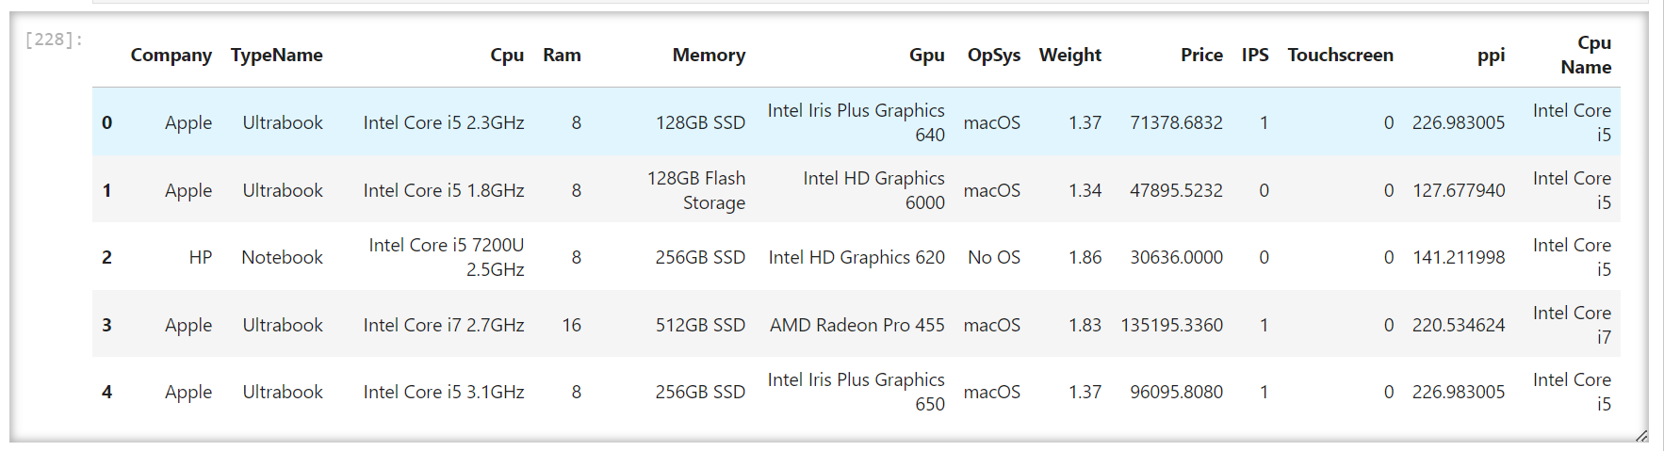
Now we will focus on cpu and gpu cpu
df['Cpu'].value_counts()
df['Cpu'].apply(lambda x:x.split()[0:3])
## I will create a new column [Cpu Name]
df['Cpu Name'] = df['Cpu'].apply(lambda x:" ".join(x.split()[0:3]))
df.head()

Slide 20
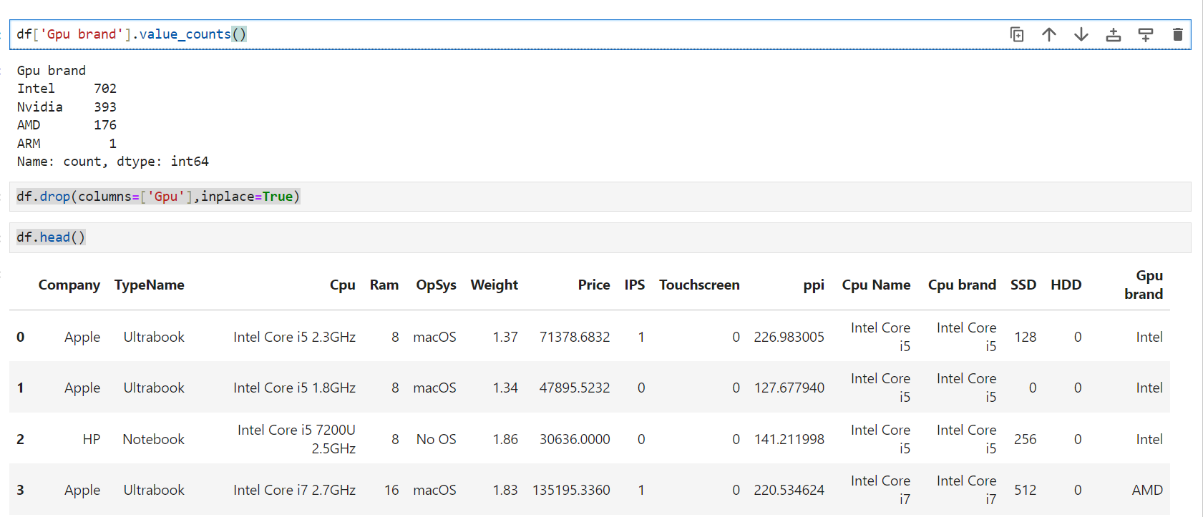
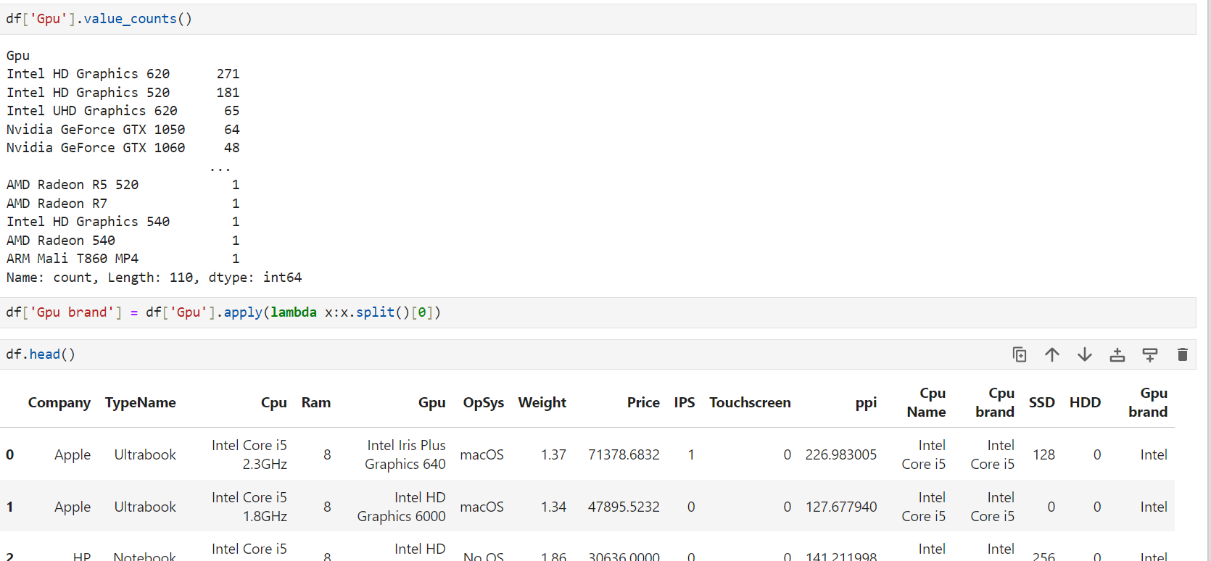
Gpu
df['Gpu'].value_counts()
df['Gpu'].value_counts()
df['Gpu brand'] = df['Gpu'].apply(lambda x:x.split()[0])
df.head()
df['Gpu brand'].value_counts()
df.drop(columns=['Gpu'],inplace=True)
df.head()

Slide 21
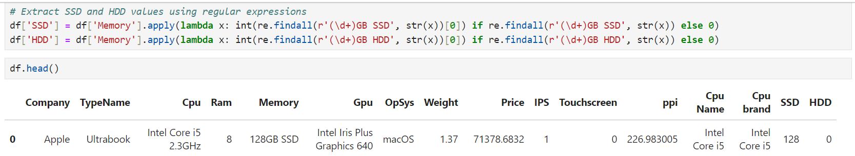
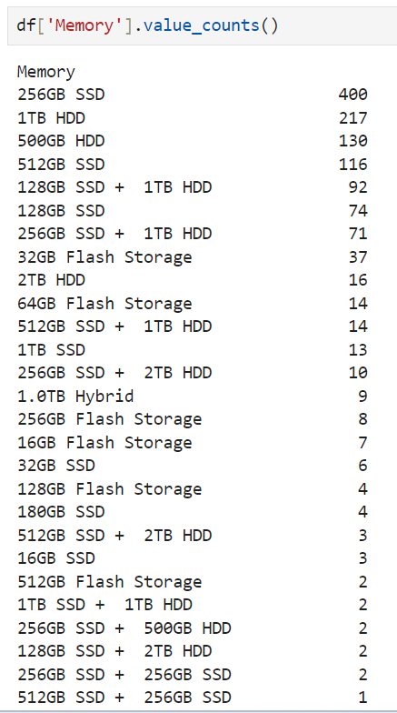
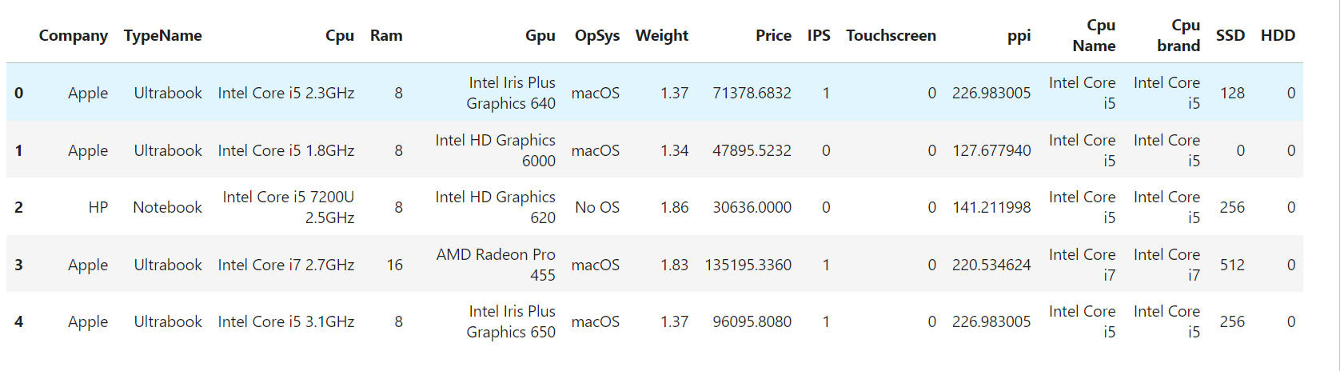
Now we will focus on memory
df['Memory'].value_counts()
import re
# Extract SSD and HDD values using regular expressions
df['SSD'] = df['Memory'].apply(lambda x: int(re.findall(r'(\d+)GB SSD', str(x))[0]) if re.findall(r'(\d+)GB SSD', str(x)) else 0)
df['HDD'] = df['Memory'].apply(lambda x: int(re.findall(r'(\d+)GB HDD', str(x))[0]) if re.findall(r'(\d+)GB HDD', str(x)) else 0)
df.head()
df.drop('Memory', axis=1, inplace=True)

Slide 22
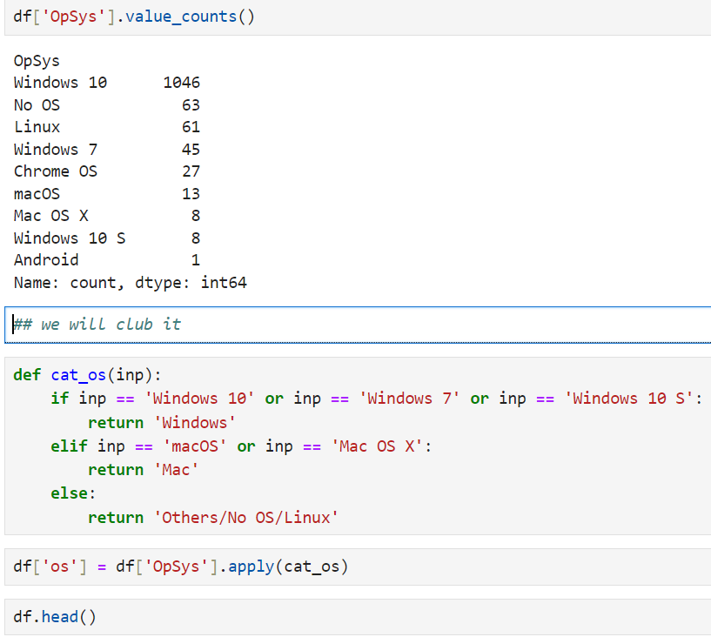
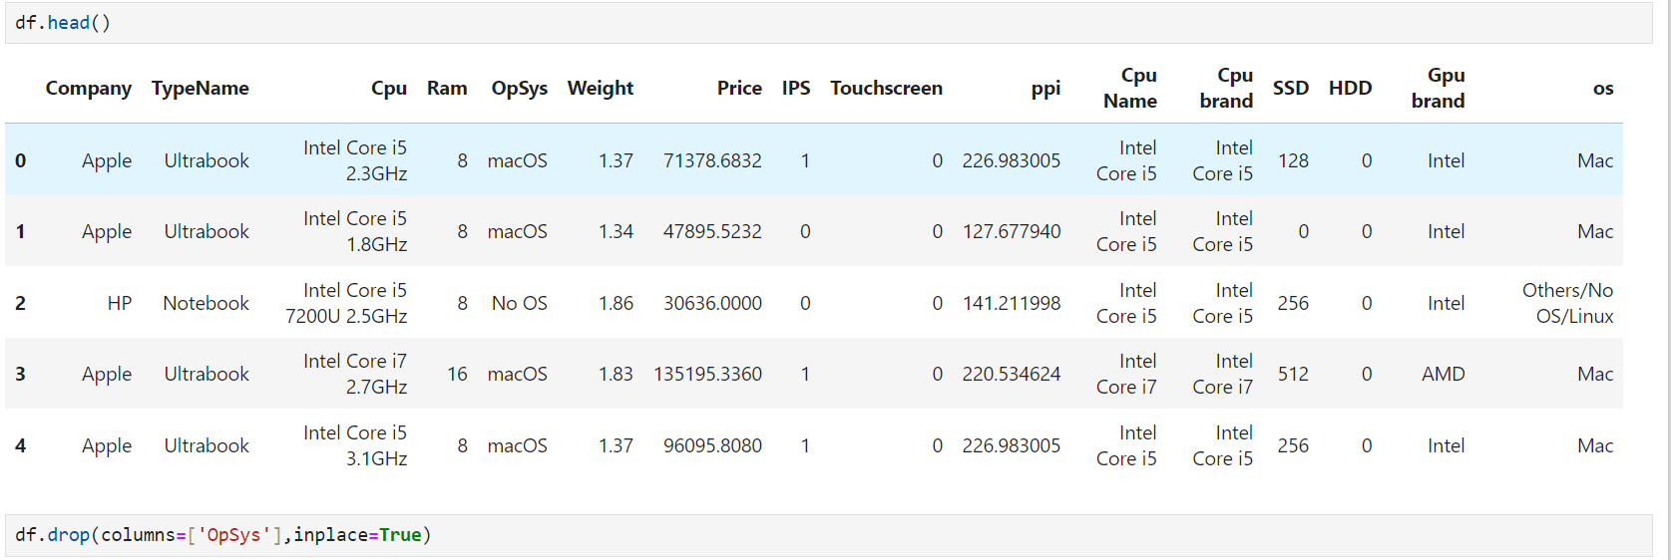
Operating system

Slide 23
EDA of Laptop Price Prediction Dataset
Exploratory analysis is a process to explore and understand the data and data relationship in a complete depth so that it makes feature engineering and machine learning modeling steps smooth and streamlined for prediction.
EDA involves Univariate, Bivariate, or Multivariate analysis.
EDA helps to prove our assumptions true or false. In other words, it helps to perform hypothesis testing.
# import the neccesary libraries
import seaborn as sns
import matplotlib.pyplot as plt
THE EPICENTRE OF EDA IS PRICE

Slide 24
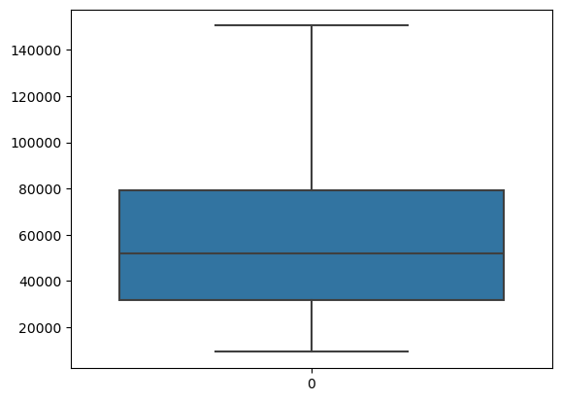
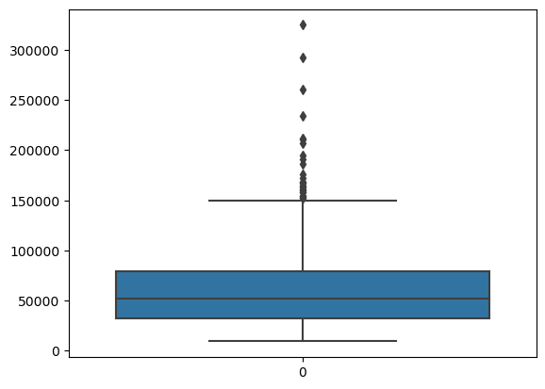
Treating outliers
q3=df.describe()['Price']['75%']q1=df.describe()['Price']['25%’]
iqr=q3-q1upper=q3+1.5*iqr
lower=q1-1.5*iqr
df['Price']=df['Price'].clip(upper,lower)
# Filling the null values with median of each varibledf['Ram']=df['Ram'].fillna(df['Ram'].median())
df['Weight']=df['Weight'].fillna(df['Weight'].media)))
df['Price']=df['Price'].fillna(df['Price'].median())
sns.boxplot(df['Price'])

Slide 25
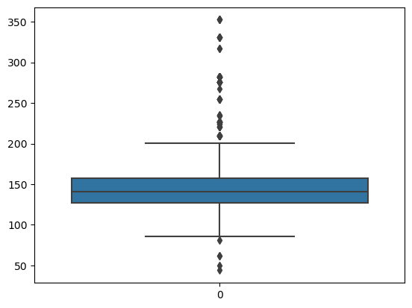
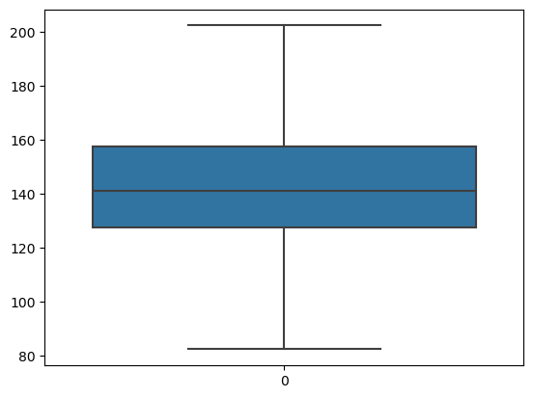
Treating outliers
q3=df.describe()['ppi']['75%’]
q1=df.describe()['ppi']['25%’]
iqr=q3-q1upper=q3+1.5*iqr
lower=q1-1.5*iqrdf['ppi']=df['ppi'].clip(upper,lower)
import seaborn as snssns.boxplot(df['ppi'])
sns.boxplot(df['ppi'])

Slide 26
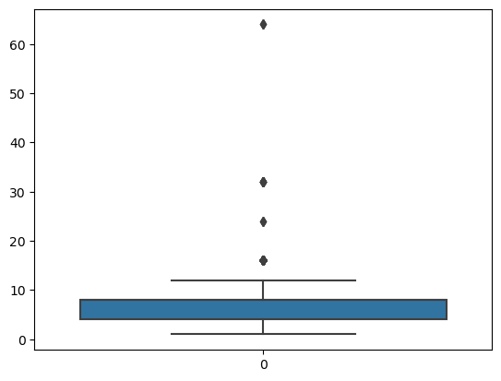
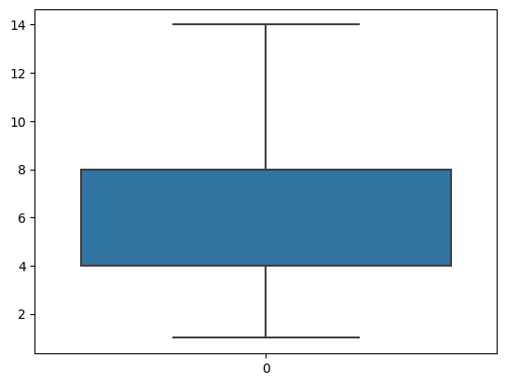
Treating outliers
q3=df.describe()['Ram']['75%’]
q1=df.describe()['Ram']['25%’]
iqr=q3-q1upper=q3+1.5*iqr
lower=q1-1.5*iqrdf['Ram']=df['Ram'].clip(upper,lower)
sns.boxplot(df['Ram'])
sns.boxplot(df['Ram'])

Slide 27
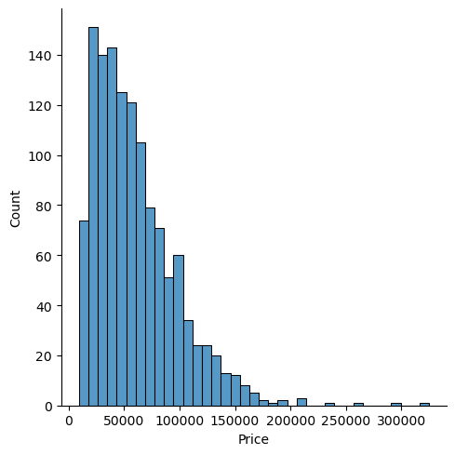
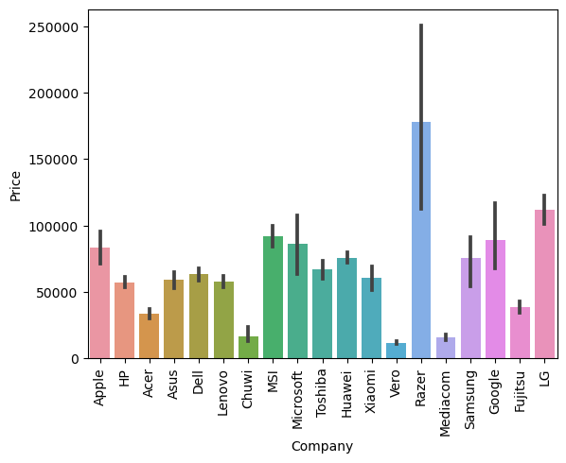
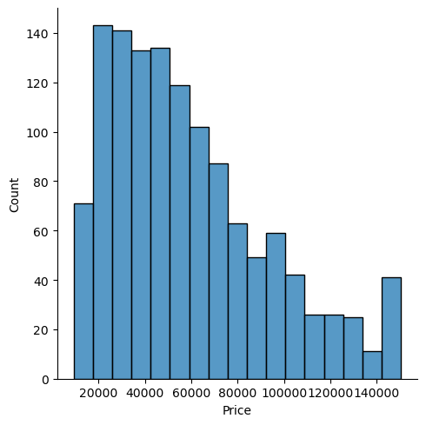
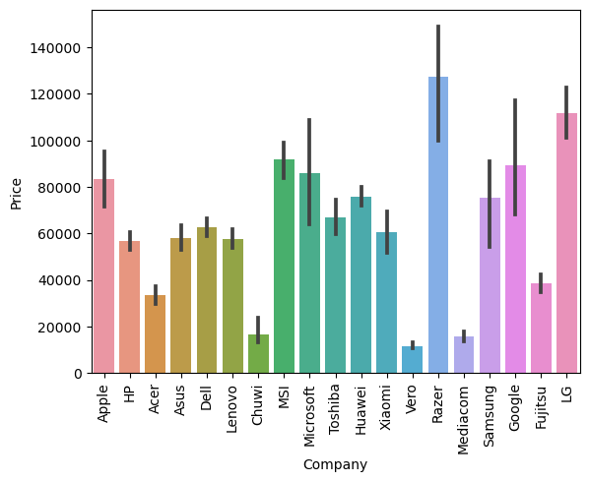
PRICE ANALYSIS
sns.displot(df['Price'])
sns.barplot(x=df['Company'],y=df['Price'])plt.xticks(rotation='vertical')plt.show

Slide 28
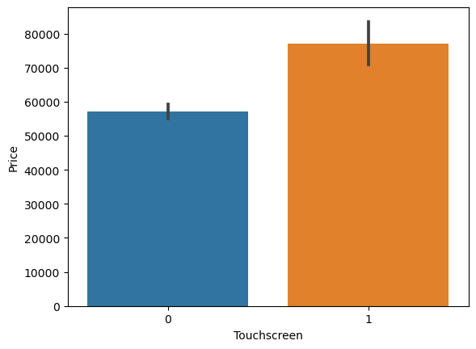
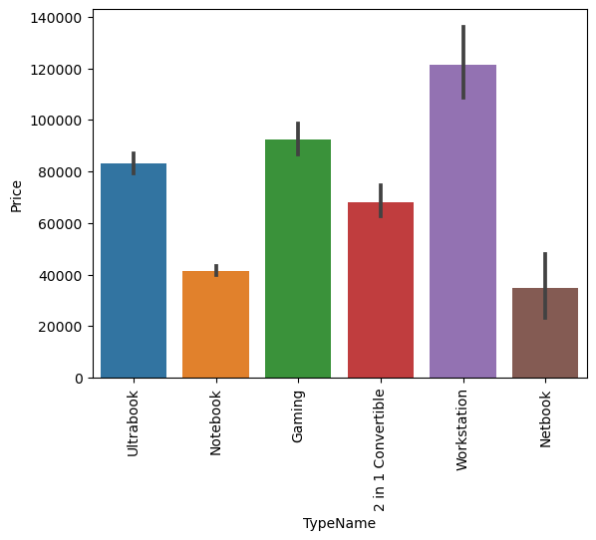
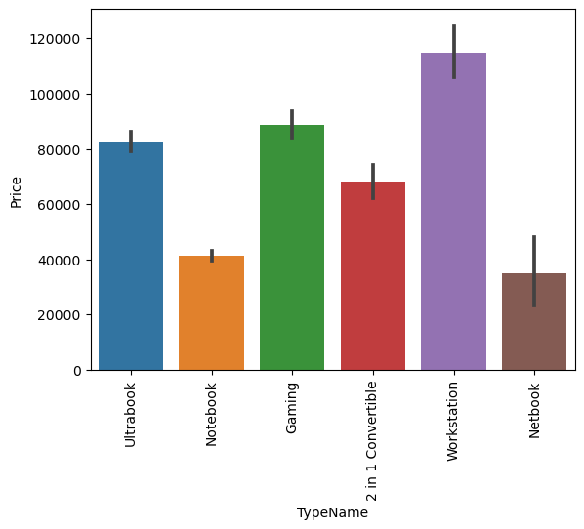
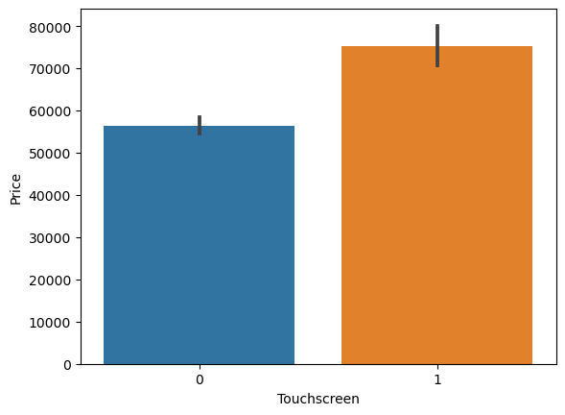
PRICE ANALYSIS
sns.barplot(x=df['Touchscreen'],y=df['Price'])
sns.barplot(x=df['TypeName'],y=df['Price'])plt.xticks(rotation='vertical')plt.show

Slide 29
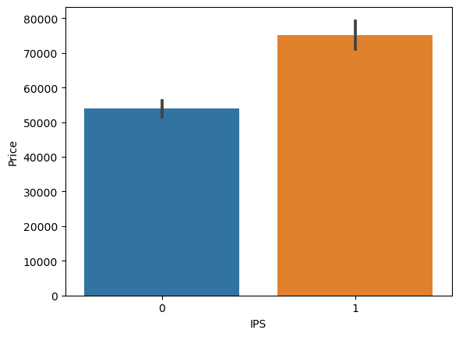
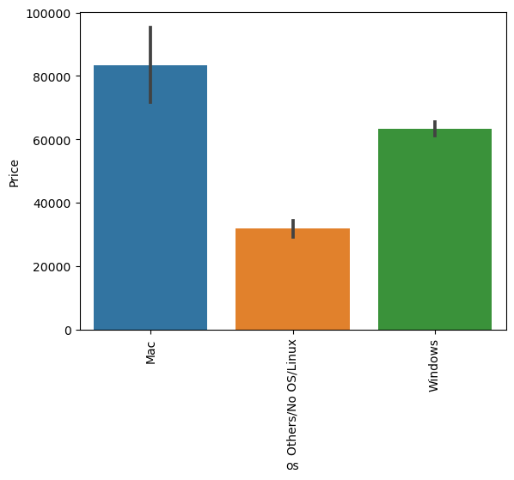
PRICE ANALYSIS
sns.barplot(x=df['IPS'],y=df['Price'])
sns.barplot(x=df[‘os'],y=df['Price'])plt.xticks(rotation='vertical’)
plt.show()

Slide 30
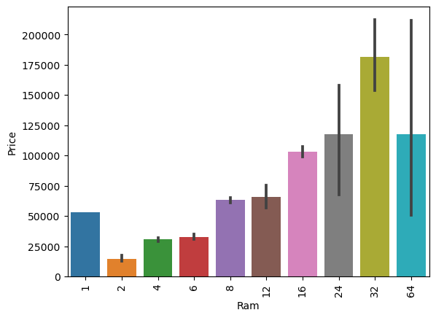
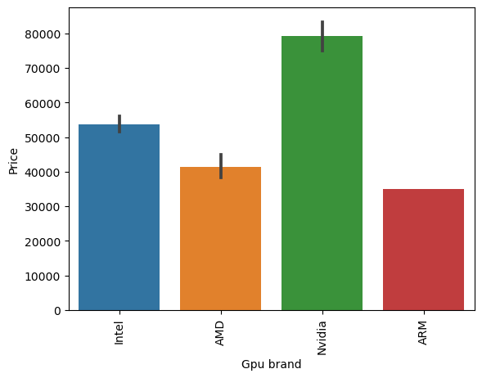
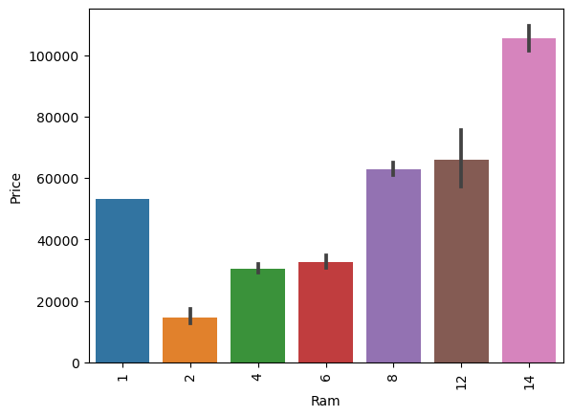
PRICE ANALYSIS
sns.barplot(x=df[‘Gpubrand'],y=df['Price'])plt.xticks(rotation='vertical’)
plt.show
sns.barplot(x=df['Ram'],y=df['Price'])plt.xticks(rotation='vertical')plt.show

Slide 31
MACHINE LEARNING : Model Training & Model Testing
### Machine Leaning Problem It is a Regression problem, for a given columns we need to predict the price of laptop.
Performance Metric
1). R2 Score
2).Mean Absolute Error

Slide 32
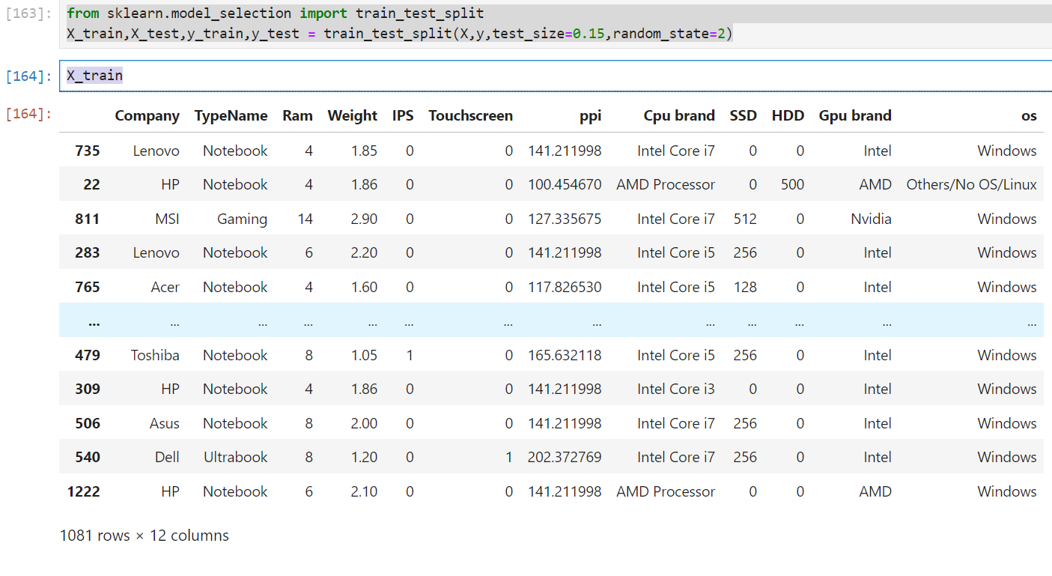
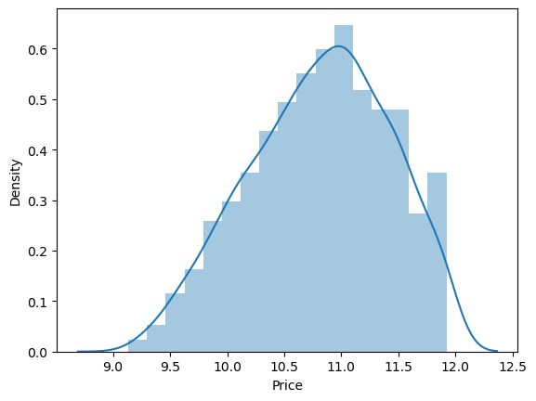
MODEL TRAINING
from sklearn.model_selection import train_test_splitX_train,X_test,y_train,y_test = train_test_split(X,y,test_size=0.15,random_state=2)
X_train
### Normalisation
#### extract x and y by applying log transformation.
It will increase the value of R2.
sns.distplot(np.log(df['Price']))

Slide 33
Machine Learning Modeling for Laptop Price Prediction
Now we have prepared our data and hold a better understanding of the dataset. so let’s get started with Machine learning modeling and find the best algorithm with the best hyperparameters to achieve maximum accuracy.
Import Libraries
from sklearn.compose import ColumnTransformer
from sklearn.pipeline import Pipeline
from sklearn.preprocessing import OneHotEncoder’
from sklearn.metrics import r2_score,mean_absolute_error
!pip install xgboost==1.7.5
from sklearn.linear_model import LinearRegression,Ridge,Lasso
from sklearn.neighbors import KNeighborsRegressor
from sklearn.tree import DecisionTreeRegressor
from sklearn.ensemble import RandomForestRegressor,GradientBoostingRegressor,AdaBoostRegressor,ExtraTreesRegressor
from sklearn.svm import SVRfrom xgboost import XGBRegressor
from sklearn.cluster import AffinityPropagation

Slide 34
Implement Pipeline for training and testing
Now we will implement a pipeline to streamline the training and testing process. first, we use a column transformer to encode categorical variables which is step one. After that, we create an object of our algorithm and pass both steps to the pipeline. using pipeline objects we predict the score on new data and display the accuracy.

Slide 35
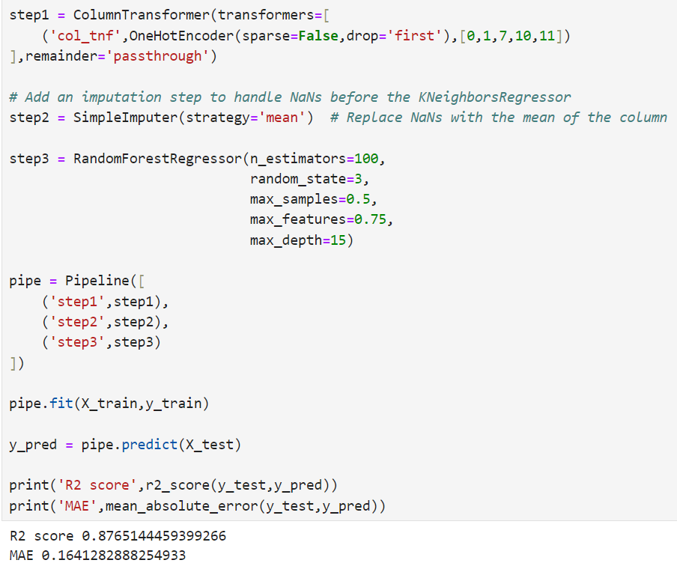
RANDOM FOREST
Implement Pipeline for training and testing

Slide 36


LINEAR REGRESSION
DECISION TREE

Slide 37

STACKING
# What is stacking in machine learning?
# Stacking is one of the most popular ensemble machine learning techniques.
# used to predict multiple nodes to build a new model and improve models performance.

Slide 38
CONCLUSION
The development of a robust machine learning model for predicting laptop prices has yielded valuable insights into the dynamic landscape of the tech market for SmartTech Co. Through meticulous data exploration, preprocessing, and model development, we've identified key features influencing[ (Company) (TypeName) (Ram) (Weight) (IPS) (Touchscreen) (ppi) (Cpu brand) (SSD) (HDD) (Gpu brand) (os) ]
while demonstrating the model's efficacy in accurately predicting prices across various brands and specifications. Leveraging real-time prediction capabilities, SmartTech Co. can strategically position its laptops in the market, optimize pricing strategies, and swiftly respond to market shifts, ensuring competitiveness and customer satisfaction in an ever-evolving industry.

Slide 39
Questions to Explore:
1). Which features have the most significant impact on laptop prices?
-> The most significant features on price is 'Ram','Gpu brand','os' and'PPi' due to it have strong correlation with price.
2). Does the brand of the laptop significantly influence its price?
-> Only applies to apple and gaming laptop. But for remaining it depends on the configuration.
3). How well does the model perform on laptops with high-end specifications compared to budget laptops?
-> Model doesn't differentiate and performs reasonably well on both ends of specifications.
4). What are the limitations and challenges in predicting laptop prices accurately?
certain brands, configurations etc.
-> Major Limitation is lack of sufficient data of most laptop companies which will adversely effect in predictingcertain brands,configurations etc

Slide 40


Create GUI of Laptop Price Prediction Mode
!pip install gradio==4.29.0
import gradio as grimport pandas as pdimport pickle
df = pd.read_csv('laptop.csv’)
pipe = pickle.load(open('pipe.pkl','rb'))

Slide 41

Define the input components for the interface

Slide 42

Laptop Prediction GUI

Slide 43




Thank You
REHAN ASLAM KHAN
+91 8968832194
16rehan687@gmail.com
Github.com

